Slide 1

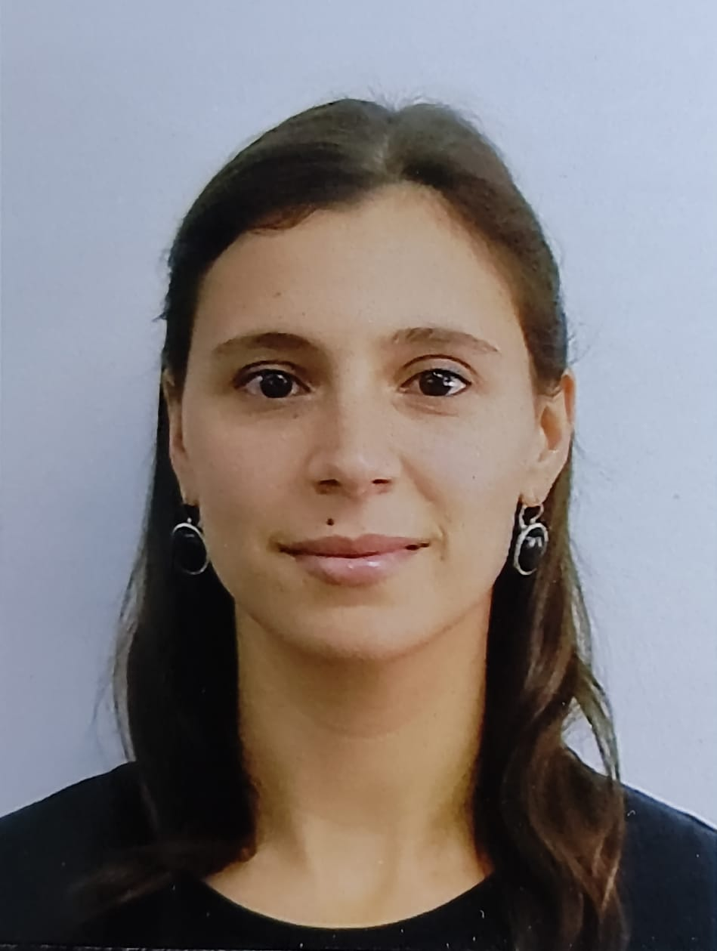



Ana Penacchioni
SELECTED EXPERIENCE
Sempra Energy (06 2022 – 11 2023)​
Working as Data scientist on this project, putting together skills such as AWS Lambda, Glue, S3, git, VS Code/PyCharm, setting up integration tests, and coordinating Terraform implementation with the Back End team.
CDAO (11 2023 – present)​
Relevant activities/knowledge.
Relevant activities/knowledge.
Relevant activities/knowledge.
<Business description> (MM YYYY – MM YYYY)​
Relevant activities/knowledge.
Relevant activities/knowledge.
Relevant activities/knowledge.
<Business description> (MM YYYY – MM YYYY)​
Relevant activities/knowledge.
Relevant activities/knowledge.
Relevant activities/knowledge.
<Business description> (MM YYYY – MM YYYY)​
Relevant activities/knowledge.
Relevant activities/knowledge.
Relevant activities/knowledge.
MLE Senior Analyst
Technology
ana.penacchioni@accenture.com
Buenos Aires, Argentina
PROFESSIONAL BACKGROUND
AREA OF EXPERTISE
Astrophysics researcher at Universidad Nacional de La Plata (UNLP), with +10 years of experience.
MLE Data Analyst at Accenture Applied Intelligence Latam Hub.
PhD in Astrophysics, Sapienza University of Rome
HARD/SOFT SKILLS & TOOLS
Skill 1: Data Analysis and Interpretation
Skill 2: Cloud
Skill 3: Linux
Skill 4: Team worker
Skill 5: Data Science
Skill 6: Python
Skill 7: Git
Skill 8: Machine Learning
Skill 9: LATEX, Open Office, Xspec, HEASOFT
Skill 10: Fortran, Shell
Skill 11: Gen AI and LLM
EDUCATION
SPECIALIZATIONS
AWS Cloud Practitioner / Solutions Architect
GCP Cloud Digital Leader
LANGUAGES
English (proficiency)
Italian (proficiency)
Spanish(Native)
Portuguese (Intermediate)
French (Intermediate)
INDUSTRY
Science
Aerospace
Satellite
Energy
Teaching
Accenture Applied Intelligence

